Slide 1
Draft Statute of the Multilateral Investment Court
Marc Bungenberg and August Reinisch

Slide 2
Overview
Criticism of the current ISDS system
Calls for permanent, multilateral alternatives to Investor-State Arbitration (ISA), i.e. a multilateral investment court or an appellate mechanism
Our specific proposal:
Draft Statute for a Multilateral Investment Court
Select Organizational Issues
Select Procedural Issues

Slide 3
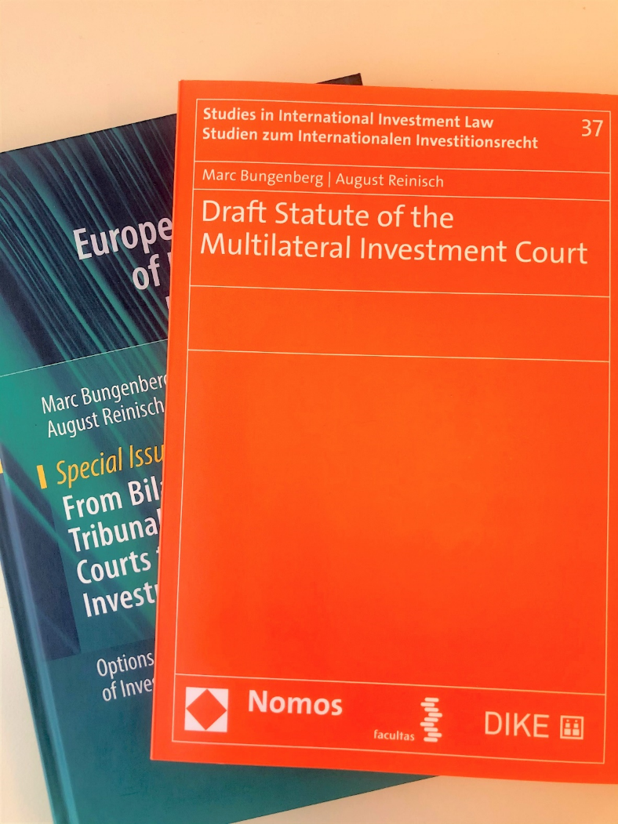
MIC Proposal
2018 study: “From Bilateral Arbitral Tribunals and Investment Courts to a Multilateral Investment Court” (Bungenberg/Reinisch)
Implementing ‘rule of law’ demands into two suggested models:
Two-tiered Multilateral Investment Court (MIC)
Multilateral Investment Appellate Mechanism (MIAM)
Based on the 2018 study: 2020 Draft Statute of the Multilateral Investment Court (Bungenberg/Reinisch)

Slide 4
Organizational Issues
MIC as a new international organization established by treaty
Power to enter into a seat agreement
Legal personality
Privileges and immunities

Slide 5
Membership
States and REIOs:
Article 4(2):
“States and other international entities, which have the power to enter into investment agreements, may accede to the MIC.”

Slide 6
Organs
Article 3:
“The MIC shall have the following organs:
(a) The Plenary Body
(b) The Court of First Instance
(c) The Appellate Court
(d) The Advisory Centre
(e) The Secretariat.”

Slide 7
Plenary Body
consists of Member (States) representatives
elects judges,
approves budget,
adopts secondary law (rules of procedure, regulations and guidelines, etc.),
adopts amendments and interpretations of the Statute

Slide 8
Judges
24 full-time, judges “persons of high moral character, enjoying the highest reputation for fairness and integrity with recognised competence in the fields of public international law, especially international investment law and international dispute settlement, administrative, commercial and constitutional law.” (Article 9 para. 2)

Slide 9
Judges
(initially 24 judges –selective representation model) elected by the Plenary Body
guaranteeing diversity (regional groups as in UN) based on member nominations and after scrutiny by a Screening Committee
serving for non-renewable 9-year terms
in chambers, grand-chambers or plenary
or (9 judges) on the Appellate Court

Slide 10
Advisory Centre
to provide legal assistance for disputes to:
(a) companies which are eligible for classification as Small and Medium Enterprises (SME) and
(b) all Members who are regarded as ‘developing economies’ pursuant to the Country Classification of the United Nations system.
to provide training and education

Slide 11
Secretariat
headed by Director-General appointed by Plenary Body
provides administrative and legal support also to Judges

Slide 12
Jurisdiction
“The jurisdiction of the MIC comprises all disputes arising directly out of an investment of a national of a Member in the territory of another Member, which the parties to the dispute refer to the MIC through consent in writing. […].”
Article 19(1)

Slide 13
Jurisdiction
“A Member may express its consent to the jurisdiction of the MIC as required under Article 19(1) by communicating such consent in writing at the time of accession, acceptance or approval of this Statute. Unless otherwise stated, such consent shall extend to the dispute settlement provisions of the Agreements listed in Annexes X of this Statute, including future International Investment Agreements of Members to the MIC. […]”
Article 20(1)

Slide 14
Jurisdiction
Article 19 Scope of Jurisdiction The jurisdiction of the MIC comprises all disputes arising directly out of an investment of a national of a Member in the territory of another Member, which the parties to the dispute refer to the MIC through consent in writing. When the parties have given their consent, no party may withdraw its consent unilaterally. For the purpose of this Statute a ‘national of another Member’ means: any natural person who had the nationality of a Member other than the Member which is a party to the dispute on the date on which the parties consented to submit such dispute to the MIC as well as on the date on which the request was registered pursuant to Article 44(2); and any juridical person which had the nationality of a Member other than the Member which is a party to the dispute on the date on which the parties consented to submit such dispute to the MIC as well as on the date on which the request was registered pursuant to Article 44(2). For the purposes of this Statute, a juridical person with the nationality of a Member shall be an enterprise that is constituted or organised under the laws of that Member and has substantial business activities in the territory of that Member, or an enterprise that is constituted or organised under the laws of that Member and is directly or indirectly owned or controlled by a natural person of that Member or by an enterprise mentioned under paragraph (i).
Consent:
Future treaties and listed IIAs in Annexes (Art 20);
Investment contracts (Art 21);
Exclusivity of jurisdiction when IIA contracting states are also MIC states (Art 23);
Possibility of state-to-state dispute settlement (Art 22);
Prohibition of diplomatic protection (Art 25);
Jurisdiction Ratione temporis: Only disputes arising out after the entry into force of the Statute (Art 26).

Slide 15
Two-Tier System
Appellate Court (Court of Second Instance)
Court of First Instance

Slide 16
Two-Tier System …
Court of First Instance
Period for submitting: One year after dispute arose or local remedies were exhausted (Art 42(1)); Except special agreements, no claim beyond 10 years after alleged violation (Art 42(2)) Time-limits for decisions: 6 months (Art 43(1)); Extension possible (if informed and reasoned), but maximum 9 months (Art 43(2)) Composition of Judges: Chambers of 3 judges (decision by majority) (Art 44(1-3)) Sole judge only by request (Art 44(4)) Summary dismissal: if claim inadmissible, manifestly ill-founded, or there is manifest lack of jurisdiction (Art 44(2))

Slide 17
Two-Tier System …
Appellate Court
Period for submitting: 90 day after first instance decision; if corruption alleged, 90 days after the discovery of corruption (Art 47(1)) Grounds for Appeal (Art 46) lack of jurisdiction or inadmissibility; manifest excess of powers; corruption of the judges; serious departure from fundamental rule of procedure; failure to state reasons; grave errors in the application/interpretation of the law; manifest errors in the appreciation of facts or domestic law Time-limits for decisions: 90 days; or maximum 120 days (Art 48) Composition of Judges: chambers of 3 judges; exceptionally, larger chambers or plenary of Appellate Court judges (Art 47(2))

Slide 18
General (Procedural) Principles
Article 28 General Principles 1. The MIC establishes a mechanism for the settlement of investment disputes that assures both equal treatment among investors of the Members in accordance with the principle of reciprocity and due process before an independent and impartial adjudicator. By performing their duties, the judges of the MIC shall: (a) adhere to the Rule of Law; (b) promote the transparency of the proceedings through application of the rules, inter alia on transparency, ethics and conduct which govern them; (c) ensure that the proceedings are carried out efficiently and expeditiously; (d) secure uniform and consistent interpretation of the law, taking into consideration previous decisions without establishing a doctrine of precedent, particularly where there exists sufficient uniformity in previous case law; and (e) take into account the Members’ right to regulate. 2. The proceedings and functioning of all the organs of the MIC will adhere to the highest standards of the rule of law, transparency, and good governance. All proceedings shall be conducted in accordance with the provisions of this Part and, except as the parties otherwise agree, in accordance with the Rules of Procedure adopted by the Plenary Body in effect on the date of the proceedings.
In a nutshell…
Adherence to the Rule of Law;
Equal treatment and due process;
Transparency;
Procedural efficiency;
Consistent interpretation of the law;
Considering the right to regulate.

Slide 19
General (Procedural) Principles …
Transparency
The Plenary Body will implement the UNCITRAL Rules of Transparency in Treaty-based Investor-State Arbitration (Art 8(4))
Public hearings
Publications of documents
Participation of third parties (non-disputing parties and non-disputing Party to the treaty)

Slide 20
General (Procedural) Principles …
Efficiency
Strict time limitations in:
Submission of the claim: One year after dispute arose or local remedies were exhausted (Art 42(1))
Decision of first instance: 6 months; max. 9 months (Art 43)
Request for Appeal: 90 day after first instance decision; if corruption alleged, 90 days after the discovery of corruption (Art 47(1)
Decision of second instance: 90 days; or maximum 120 days (Art 48)

Slide 21
Applicable Law
Article 31 Applicable Law 1. The MIC shall decide a dispute in accordance with such rules of law as may be agreed by the parties. In the absence of such agreement, the MIC shall apply such rules of international law as may be applicable. 2. The MIC may not submit a finding of non liquet on the ground of silence or obscurity of the law. 3. The provisions of paragraphs 1 and 2 shall not prejudice the power of the MIC to decide a dispute ex aequo et bono if the parties so agree. In such case, no recourse to the Appellate Court is available.
In a nutshell…
Law agreed by the parties (international law as a default option)
Applicable investment treaties (are integral part of the Statute)
Substantive standardization is possible later on
More uniform interpretation due to permanent Judges is likely
Judges shall take into account Members` right to regulate
The Court must decide (prohibition of non liquet)

Slide 22
Enforcement of Decisions
In MIC Members (Art 56) | Enforcement “as if it were a final judgment of a court in that State”; MIC Members designate the appropriate court for enforcement; Execution governed by laws concerning the execution of judgments in that State; Non-MIC Members may commit to enforcement in accordance with these rules.
In non-MIC Members (Art 57) | Separate treaty
Enforcement Fund (Art 58)
MIC Members must contribute to the Fund; The Fund will pay a successful claimant (especially SME) upon request: If demonstrated urgency; Limited by a cap sum. Subrogation of the MIC towards the original debtor.

Slide 23
Thank you for your attention!

